Slide 1

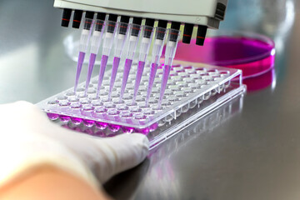
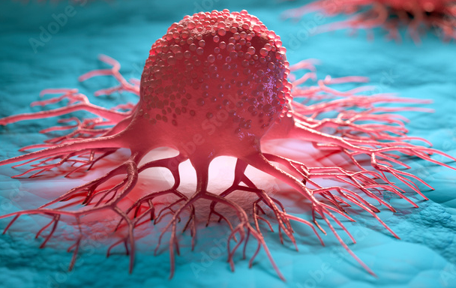

Hands - on Training & Certifications on Basic Cell Culture Technology
Winter offer
2 Days Work Shop
Introduction to Cell Culture
Lab Setup and Safety Procedures
Media and Reagents for Cell Culture
Types of Cells and Cell Lines
Aseptic Technique
Cell Culture Procedures
Cryopreservation and Cell Banking
Quality Control and Troubleshooting
Only on
1649/-
-: Get in Touch :-
www.clinitree.com , 7848035785

