Slide 1
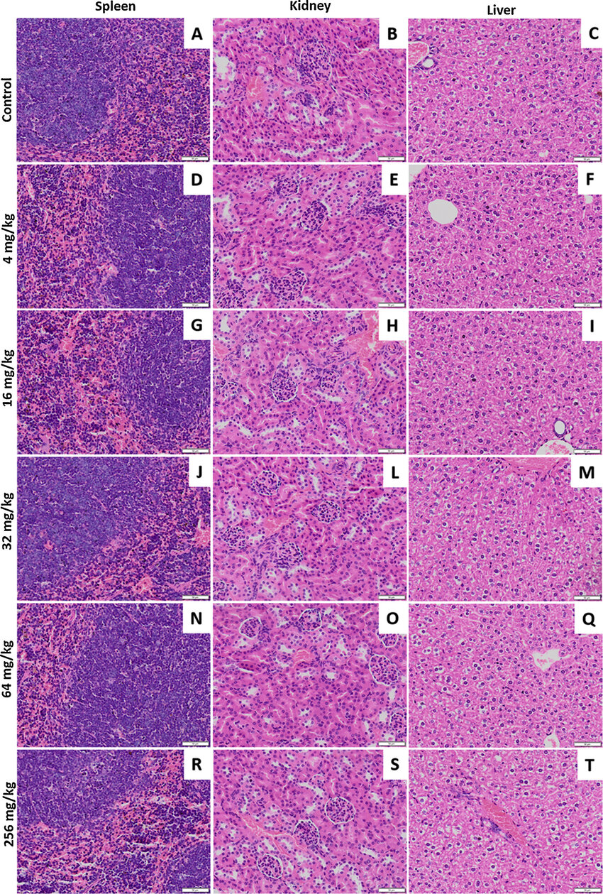
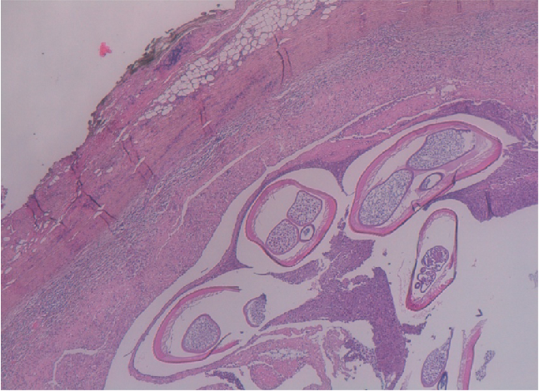
Hands-on-Training on Histopathological Analysis
Study of chemical and disease-induced tissue alterations at microscopic level.
Viewing tissue samples under a microscope to find structural and functional anomalies.
Diagnose illnesses, guide treatment choices, and evaluate the course of a disease
Crucial in medical specialties such as infectious diseases, cardiology, neurology, and cancer.
Qualitative and quantitative analysis of toxicity.
An essential diagnostic tool.
Vital information on microscopic tissue changes.

Slide 2
Days | 2 | 5 | 10 | 3 Months
Module | Experimental animals Module 1 | Necropsy Study Module 2 | Histopathology Module 3 | Safety Pharmacology (CNS) Module 4
 | 1. Various Animal Models 2. Animal Care 3. Ethics 4. Basics of Animal House Maintenance & Management 5. Handling of Mice and Rat (Expt.) 6. Anatomy & Physiology 7. Anaesthesia 8. Routes of Drug Administration | 1. Euthanasia 2. Dissection (Rat) 3. Sample Collection 4. Morphometry 5. Histopathology Instruments 6. Histopathology 7. Tissue Preservation 8. Record Maintenance | 1. Tissue Processing 2. Embedding/Moulding of tissue 3. Instrumentation 4. Tissue Sectioning and slide preparation 5. Staining Techniques 6. Microscopic observation 7. Photomicrograph acquisition 8. Histological evaluation | 1. Learning & Memory impairment 2. Locomotor activity study 3. Motor coordination study 4. Behavioural study 5. Cognition deficit/impairment 6. Methods for In vivo Imaging 7. Instrumentation 8. Data acquisition
Price | 2000 | 4500 | 9500 | 20000

